Slide 1
HUMAN COMPUTER INTERACT BASED EYE CONTROLLED MOUSE
IV Year B.Tech – Mini Project Review (Review-1)
Team Members Details
KATTA SHIVANI - 20N31A6927
L. SREENIVAS REDDY - 20N31A6933
BUYYAKAR KARTHIK - 21N35A6903
IV Year B.Tech – CSE (IOT)
Under the Guidance of
Dr.I NAGARAJU
PROFESSOR
DEPARTMENT OF EMERGING TECHNOLOGIES

Slide 2
Outline
Abstract
Introduction
Existing System
Proposed System
Difference between Existing and Proposed
Literature Review

Slide 3
Abstract
Eye Movement can be regarded as a pivot real-time input medium for human computer communication, which is important for people with physical disability.
The proposed system focuses on providing a simple and convenient interactive mode by only using user’s eye.
The system built is an eye based interface that acts as a computer mouse to translate eye movements such as blinking, gazing, and squinting towards the mouse cursor actions.
The system in discussion makes use of simple webcam and its software requirements are Python, OpenCV, NumPY and a few other packages.
An algorithm to carry out the functions of a mouse by providing a hand free interaction between humans and computers by using different expression of a face using computer vision and matching it with already stored expression.
The “Camera Mouse” system tracks the computer user’s movements with a video camera and translates them into the mouse movements of the mouse pointer on the screen.

Slide 4
Introduction
Eye tracking technology, which is based on an eye tracker that measures the movement and positions of the eye has played an increasingly important role in psychology, marketing , and user interfaces.
Eye trackers have existed for a number of years, but, early in the development of the field of eye tracking, the use of eye trackers was largely confined to laboratory experiments to observe the nature of human eye movements, rather than to use these movements as an actual control medium within a human-computer interaction (HCI) .
Because the cost of eye trackers was around 30,000 a decade ago, it was too expensive to consider use in real user-computer interfaces.
In recent years, with the development of better and cheaper components for gaze interaction, low-cost eye trackers have been produced by several high-profile companies, such as Tobii’s EyeX tracker, GazePoint’s GP3 tracker, and the Eye Tribe Tracker .

Slide 5
Existing System
Currently eye tracking mouse technology is not available at a large scale. The computer mouse or moving the finger has been a very common approach to move the cursor along the screen in the current technology.
The system detects the movement in the mouse or the finger to map it to the movement of cursor.
The people with disability will not be able to make use of the current technology.
The movements of the user are tracked using a camera and these can be mapped to the movements of the mouse pointer which is visible on the screen.
As eye tracking gear gets cheaper, new applications with the concept of using eye tracking in human-computer interaction (HCI) are clearly beginning to blossom.

Slide 6
Proposed System
The system proposed in this works based on the following action:
Squinting your eyes.
Winking.
Blinking.
Gazing.

Slide 7
Existing <vs> Proposed System
Proposed | Existing
The proposed application might have a specific,novel purpose or use case that differs from existing applications. | The application serves a well-established purpose,such as assisting individuals with disabilities in controlling a computer.
It may incorporate cutting-edge,eye-tracking technology or algorithms. | It likely relies on established eye-tracking technology and software.
The proposed application introduces new features or capabilities that are not in present existing system like blinking eyes,dragging with nose and scrolling. | The existed application would have its own set of features that have been refined over time.
The user interface in the proposed application might be designed differently,focusing on usability and user experience. | The user interface that has evolved based on user feedback and industry standards.
It has various devices and platforms might be a focus for the proposed applications. | It is already compatible with specific hardware and software configurations.

Slide 8
Literature Review
S.No | Title | Publication year & Journal | Techniques/libraries Used | Advantages | Disadvantages | Future Scope
1. | Non-contact Eye Gaze Tracking System by Mapping of Corneal Reflections | IEEE 2002 | openCV, Numpy,Dlib | High Accuracy, Non-Invasive, Natural Interaction. | Limited Range, Complex Setup, Privacy Concerns. | Virtual Reality and Augmented Reality.
2. | System for assisted mobility using eye movements based on electrooculo-graphy | IEEE 2002 | Machine Learning | Non-Invasive, Accessibility, Hands free operation, Customization. | Complex Setup, Limited Eye Movements, Cost. | It lead to significant advancement in assistive technology and healthcare.
3. | Computer operation via face orientation | 11th IAPR International Conference on, 1992 | Machine Learning and AI. | Accessibility, Gesture Recognition, Augmented Reality. | Complex Setup, Accuracy and Precision,High Cost. | Innovate in healthcare and assistive technology applications.

Slide 9
System Architecture

Slide 10
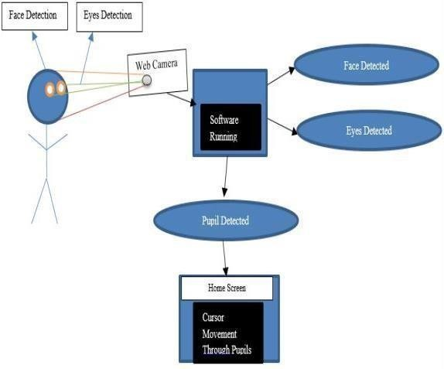
System Architecture

Slide 11
Software Requirements Specification (SRS)

Slide 12
Software Requirement (SRS)
Programming Language : Python,
IDE : pycharm , VSCODE

Slide 13
Hardware Requirement
Processor : Intel i3 and above.
RAM : 4GB and Higher.
Hard Disk : 500GB Minimum

Slide 14
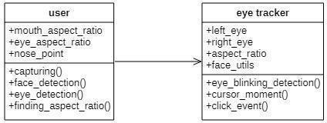
Class Diagram

Slide 15
Application Modules
Popup Screen for detecting the motion.

Slide 16
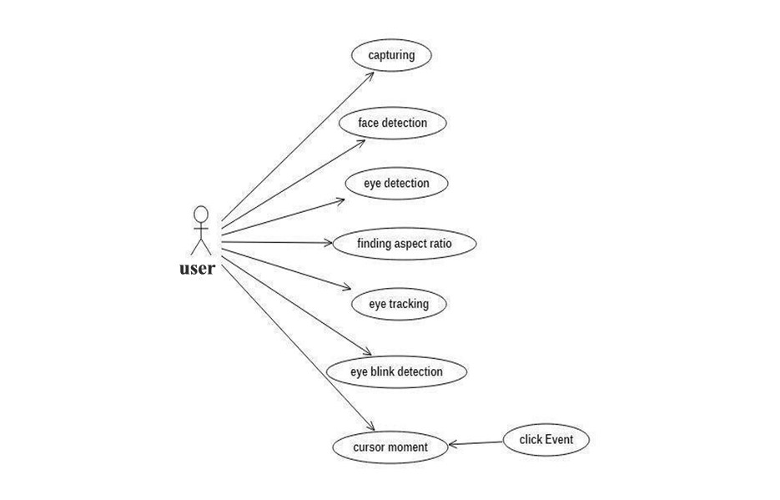
Use-Case Diagram

Slide 17
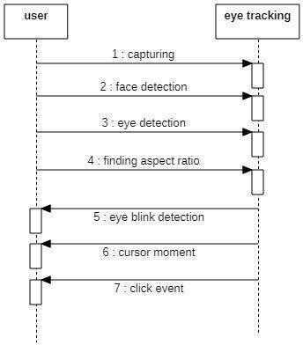
Sequence Diagram

Slide 18
About our Application
The system can be made more dynamic by making the change in the position of the cursor, proportional to the amount of rotation of the user’s head.
Also, to make the process of detection of the face more easy, some image processing techniques can be used before the model detects the face and features of the face.
In order to make user interact with computer naturally and conveniently by only using their eye, we provide an eye tracking based control system.
The system combines both themouse functions and keyboard functions, so that users can use our system to achieve almost all of the inputs to the computer without traditional input equipment.

Slide 19
Status of the Application Development
SRS finished,50% of application is finished.

Slide 20
Tentative Date of Application Completion
September 27,2023.

Slide 21
Thank you
KATTA SHIVANI 20N31A6927
L. SREENIVAS REDDY 20N31A6933
BUYYAKAR KARTHIK 21N35A6903

